Slide 1
Module 3
Network Layer: Routing – Shortest Path, Flooding, Distance Vector Routing.

Slide 2
The main function of the network layer is routing packets from the source machine to the destination machine.
Routing is an issue if the source and destination are not on the same network.
The routing algorithm is that part of the network layer software responsible for deciding which output line an incoming packet should be transmitted on.
Distinction between routing and forwarding:
Routing: is making the decision on which routes to use.
Forwarding: is what happens when a packet arrives.

Slide 3
Certain properties are desirable in a routing algorithm: correctness, simplicity, robustness, stability, fairness, and optimality.
Routing algorithms can be grouped into two major classes: non-adaptive and adaptive.
Non-adaptive algorithms
Do not base their routing decisions on measurements or estimates of the current traffic and topology.
Instead, the choice of the route to use to get from I to J (for all I and J) is computed in advance, off-line, and downloaded to the routers when the network is booted. This procedure is sometimes called static routing.

Slide 4
Adaptive algorithms:
in contrast, change their routing decisions to reflect changes in the topology, and usually the traffic as well.
Adaptive algorithms differ in:
where they get their information (e.g., locally, from adjacent routers, or from all routers),
when they change the routes (e.g., every ∆T sec, when the load changes or when the topology changes), and
what metric is used for optimization (e.g., distance, number of hops, or estimated transit time).

Slide 5
The Optimality Principle
It states that if router J is on the optimal path from router I to router K, then the optimal path from J to K also falls along the same route.
As a direct consequence of the optimality principle, we can see that the set of optimal routes from all sources to a given destination form a tree rooted at the destination. Such a tree is called a sink tree.
The goal of all routing algorithms is to discover and use the sink trees for all routers.

Slide 6
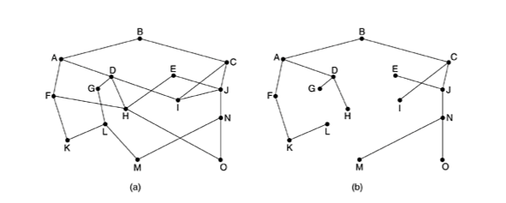
a) Subnet b) sink tree for router B

Slide 7
1. Shortest Path Routing
Several algorithms for computing the shortest path between two nodes of a graph are known. One is Dijkstra.
Each node is labeled (in parentheses) with its distance from the source node along the best known path.
Initially, no paths are known, so all nodes are labeled with infinity.
As the algorithm proceeds and paths are found, the labels may change, reflecting better paths.

Slide 8
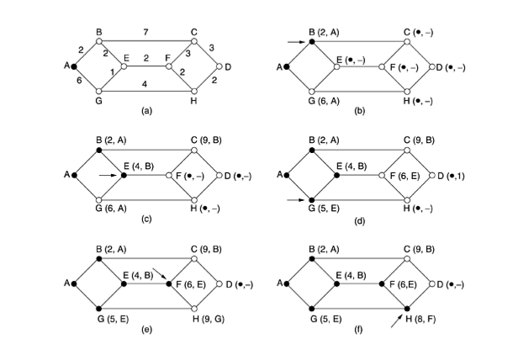
Notes:
For more : use Text : Tanenbaum

Slide 9
2. Flooding
Static algorithm.
Every incoming packet is sent out on every outgoing line except the one it arrived on.
Generates vast numbers of duplicate packets.
To reduce the number of duplicate packet:
a hop counter contained in the header of each packet,
which is decremented at each hop, with the packet being discarded when the counter reaches zero.
Ideally, the hop counter should be initialized to the length of the path from source to destination.
If the sender does not know how long the path is, it can initialize the counter to the worst case, namely, the full diameter of the subnet.

Slide 10
An alternative technique for damming the flood is to keep track of which packets have been flooded, to avoid sending them out a second time.
Achieve this goal is to have the source router put a sequence number in each packet it receives from its hosts.
Each router then needs a list per source router telling which sequence numbers originating at that source have already been seen.
If an incoming packet is on the list, it is not flooded.
A variation of flooding that is slightly more practical is selective flooding.
In this algorithm, the routers do not send every incoming packet out on every line, only on those lines that are going approximately in the right direction.
There is usually little point in sending a westbound packet on an eastbound line unless the topology is extremely peculiar and the router is sure of this fact.

Slide 11
Uses of flooding:
In military applications, where large numbers of routers may be blown to bits at any instant, the tremendous robustness of flooding is highly desirable.
In distributed database applications, it is sometimes necessary to update all the databases concurrently, in which case flooding can be useful.
In wireless networks, all messages transmitted by a station can be received by all other stations within its radio range, which is, in fact, flooding, and some algorithms utilize this property.
As a metric against which other routing algorithms can be compared. Flooding always chooses the shortest path because it chooses every possible path in parallel. Consequently, no other algorithm can produce a shorter delay (if we ignore the overhead generated by the flooding process itself).

Slide 12
3. Unicast Routing Protocol
Introduction
A routing table can be either static or dynamic.
A static table is one with manual entries.
A dynamic table, on the other hand, is one that is updated automatically when there is a change somewhere in the internet.
Today, an internet needs dynamic routing tables.
The tables need to be updated as soon as there is a change in the internet.
Notes:
Routing table:its in router,( forward packet to correct destination) .A routing table lists all networks for which routes are known.

Slide 13
Optimization
A router receives a packet from a network and passes it to another network.
A router is usually attached to several networks.
One approach is to assign a cost for passing through a network. We call this cost a metric.
However, the metric assigned to each network depends on the type of protocol.
Normally the cost of passing through a network is the same; it is one hop count.
So if a packet passes through 10 networks to reach the destination, the total cost is 10 hop counts.

Slide 14
Intra- and Inter-domain Routing
An internet can be so large that one routing protocol cannot handle the task of updating the routing tables of all routers.
For this reason, an internet is divided into autonomous systems.
An autonomous system (AS) is a group of networks and routers under the authority of a single administration.
Routing inside an autonomous system is referred to as intra-domain routing.
Routing between autonomous systems is referred to as inter-domain routing.

Slide 15
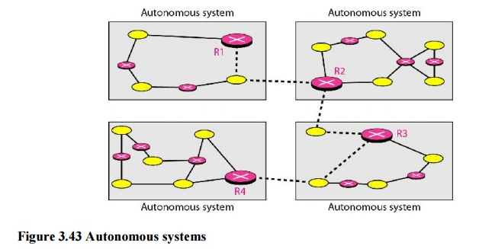

Slide 16
Two intra-domain routing protocols:
Distance vector.
Link state.
One inter-domain routing protocol:
Path vector.
Routing Information Protocol (RIP) is an implementation of the distance vector protocol.
Open Shortest Path First (OSPF) is an implementation of the link state protocol.
Border Gateway Protocol (BGP) is an implementation of the path vector protocol.

Slide 17
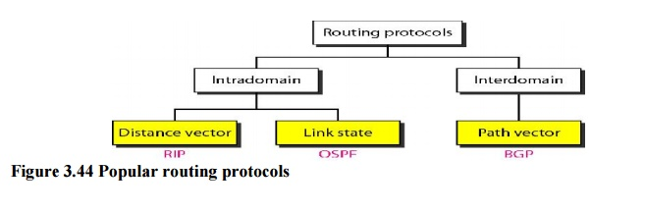

Slide 18
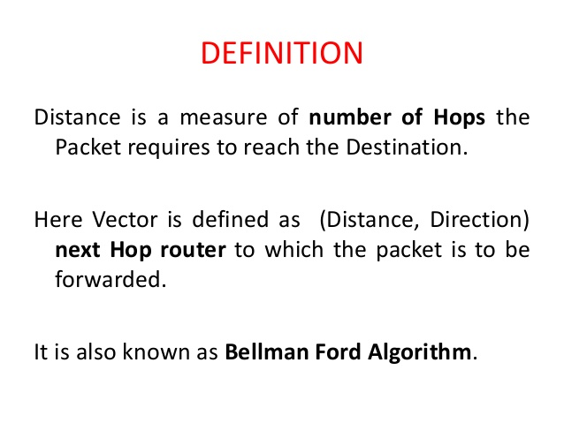
3.a. Distance Vector Routing
Notes:
https://www.brainkart.com/article/Unicast-Routing-Protocols_13481/

Slide 19
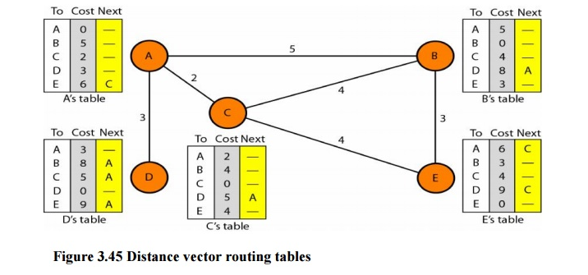

Slide 20
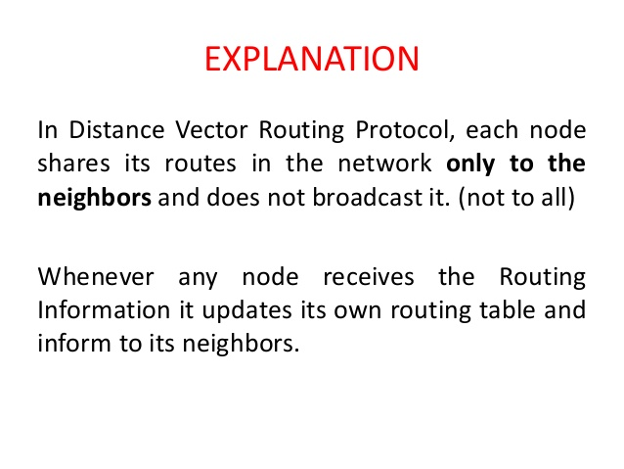

Slide 21
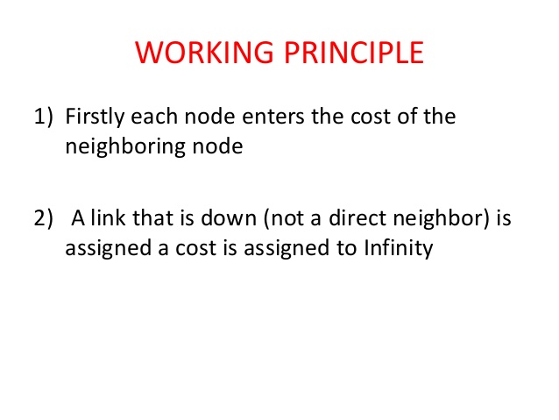

Slide 22
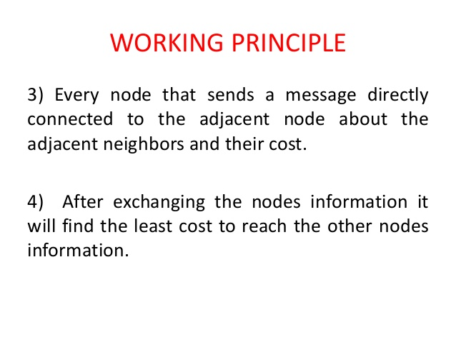

Slide 23
Drawback
Two node loop instability
Three node instability
Count to infinity problem

Slide 24
Two-Node Loop Instability
A problem with distance vector routing is instability, which means that a network using this protocol can become unstable.
To understand the problem, let us look at the scenario depicted.
This is also known as count to infinity problem.

Slide 25
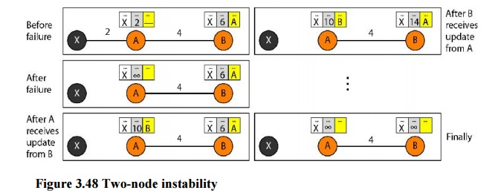

Slide 26
The picture above shows a system with 3 nodes.
At the beginning node A and B know how to reach node X.
But suddenly the link from A to X fails.
Node A changes its table.
If A can send its table to B immediately, everything is fine.
However, the system becomes unstable if B sends its routing table to A before receiving A’s routing table.
Node A receives the update and, assuming that B has found a way to reach X, immediately update its routing table.
Then A sends its new update to B (based on the triggered update strategy).
Now B thinks that something has changed around A and updates its routing table.
The cost of reaching X increases gradually until it reaches infinity.
At this moment, both A and B know that X cannot be reached.
However, during this time the system is not stable.
Packets bounce between A and B creating a two node loop problem.

Slide 27
Solutions
Defining Infinity:
The first obvious solution is to redefine infinity to a smaller number, such as 100.
As a matter of fact, most implementations of the distance vector protocol define the distance between each node to be 1 and define 16 as infinity.
However, this means that the distance vector routing cannot be used in large systems.
The size of the network, in each direction, cannot exceed 15 hops.

Slide 28
Split Horizon:
Another solution is called split horizon. In this strategy, instead of flooding the table through each interface, each node sends only part of its table through each interface.
If, according to its table, node B thinks that the optimum route to reach X is via A, it does not need to advertise this piece of information to A;
the information has come from A (A already knows). Taking information from node A, modifying it, and sending it back to node A creates the confusion. In our scenario, node B eliminates the last line of its routing table before it sends it to A. In this case, node A keeps the value of infinity as the distance to X.

Slide 29
Split horizon with poison reverse:
In this variation of split horizon, when a router sends a routing update to its neighbors, it sends those routes it learned from each neighbor back to that neighbor with infinite cost information to make sure that the neighbor does not use that route.

Slide 30
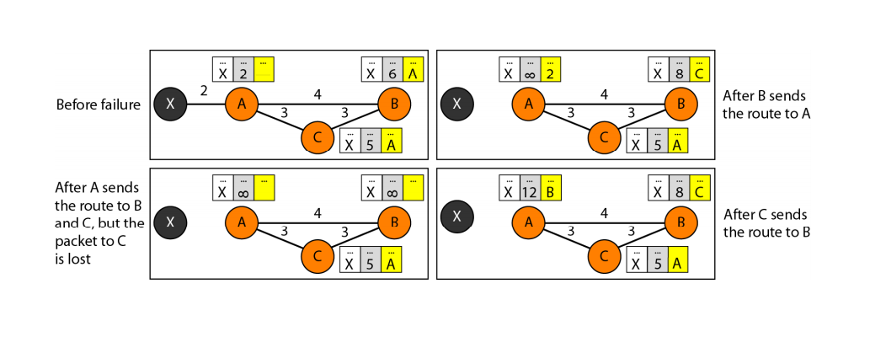
Three Node Instability

Slide 31
Suppose, after finding that X is not reachable, A sends a packet to B and C to inform them of the situation.
B immediately updates its table, but the packet to C is lost in the network and never reaches C.
C remains in the dark and still thinks that there is a route to X via A with a distance of 5.
After a while, C sends to B its routing table, which includes the route to X. B is totally fooled here.
It receives the information on the route to X from C, and according to the algorithm, it updates its table, showing the route to X with a cost of 8.
The information has come from C, not from A, so after a while, B may advertise this route to X to A.
Now A is fooled and updates its table to show that A can reach X via B with a cost of 12.
The loop continues, and stops when the cost in each node reaches infinity.

